Slide 1

Search Problems

Slide 2







Search Problems
A search problem consists of:
  A state space
  A successor function
  (with actions, costs)
  A start state and a goal test
A solution is a sequence of actions (a plan) which transforms the start state to a goal state
“N”, 1.0
“E”, 1.0
Notes:
Often comes back on exams
Goal test – sometimes more than one state that satisfies having achieved the goal, for example, “eat all the dots”
Abstraction

Slide 3
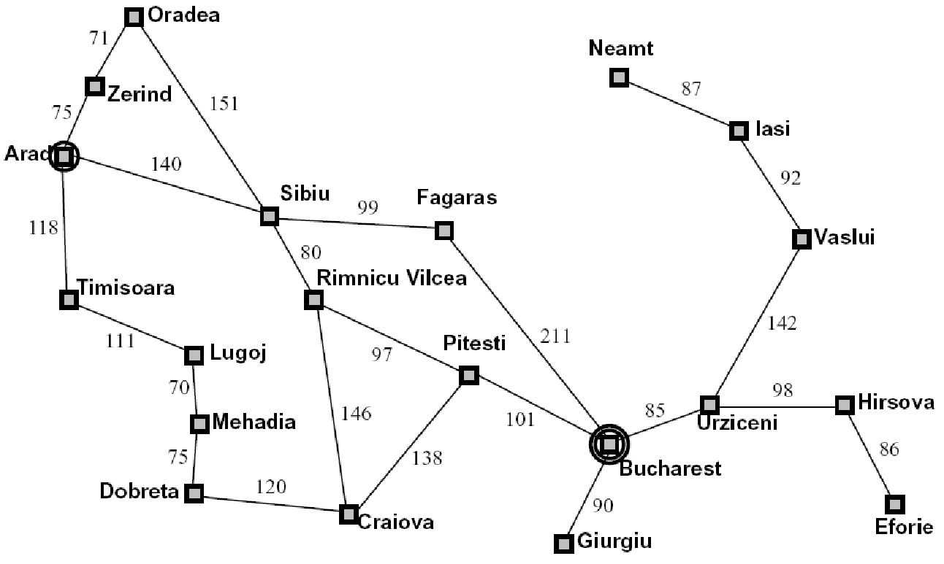
Example: Traveling in Romania
State space:
  Cities
Successor function:
  Roads: Go to adjacent city with cost = distance
Start state:
  Arad
Goal test:
  Is state == Bucharest?
Solution?

Slide 4
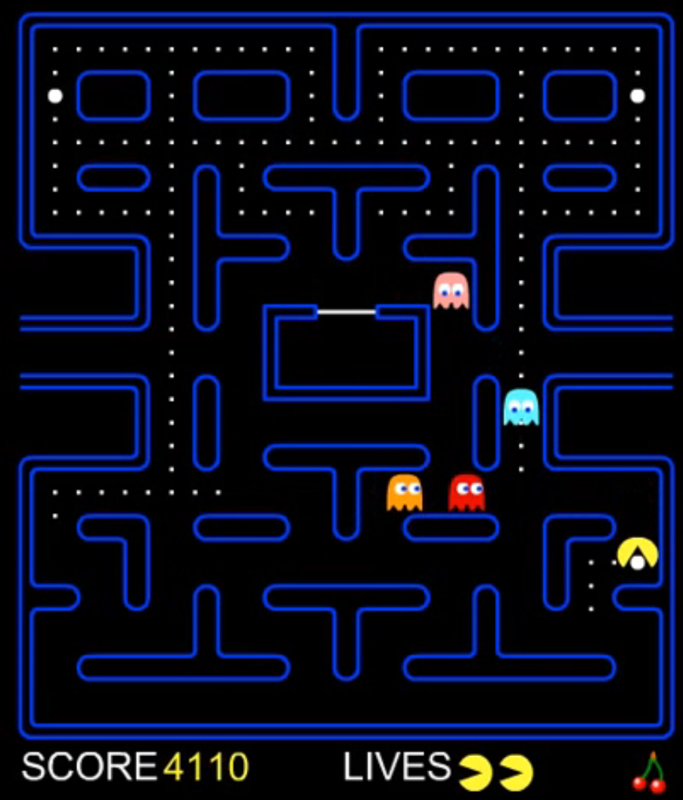
Pacman Demo
https://www.youtube.com/watch?v=1V7uBxNXOzo

Slide 5
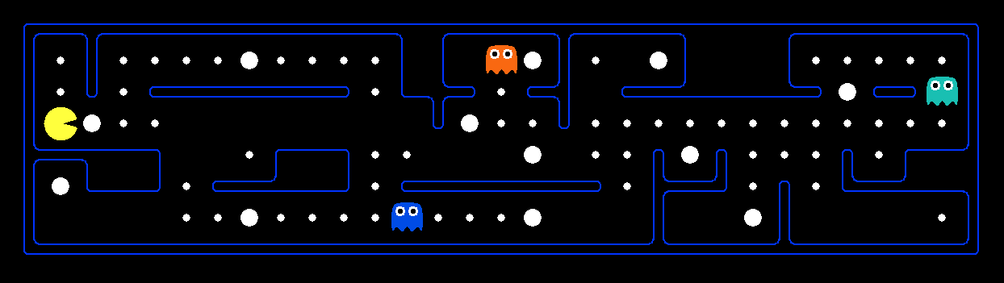
What’s in a State Space?
The world state includes every last detail of the environment
A search state keeps only the details needed for planning (abstraction)
Problem: Pathing
  States: (x,y) location
  Actions: NSEW
  Successor: update location only
  Goal test: is (x,y)=END
Problem: Eat-All-Dots
  States: {(x,y), dot booleans}
  Actions: NSEW
  Successor: update location and possibly a dot boolean
  Goal test: dots all false
Notes:
Wrong example for “eat-all-dots”: (x, y, dot count)

Slide 6

State Space Graphs and Search Trees

Slide 7
State Space Graphs
State space graph: A mathematical representation of a search problem
  Nodes are (abstracted) world configurations
  Arcs represent successors (action results)
  The goal test is a set of goal nodes (maybe only one)
In a state space graph, each state occurs only once!
We can rarely build this full graph in memory (it’s too big), but it’s a useful idea

Slide 8
State Space Graphs
State space graph: A mathematical representation of a search problem
  Nodes are (abstracted) world configurations
  Arcs represent successors (action results)
  The goal test is a set of goal nodes (maybe only one)
In a state space graph, each state occurs only once!
We can rarely build this full graph in memory (it’s too big), but it’s a useful idea
a
G
b
c
e
d
f
S
h
p
q
r
Tiny search graph for a tiny search problem

Slide 9
Search Trees
This is now / start
“N”, 1.0
“E”, 1.0
Possible futures
A search tree:
  A “what if” tree of plans and their outcomes
  The start state is the root node
  Children correspond to successors
  Nodes show states, but correspond to PLANS that achieve those states
  For most problems, we can never actually build the whole tree
Notes:
Different plans that achieve the same state, will be different nodes in the tree.

Slide 10
State Space Graphs vs. Search Trees
State Space Graph
Each NODE in in the search tree is an entire PATH in the state space graph.
Search Tree
S
a
G
d
e
p
b
c
q
b
c
e
h
r
d
e
f
a
a
h
r
p
q
f
S
h
We construct both on demand – and we construct as little as possible.
p
q
f
q
c
G
p
q
r
q
c
G
a
a

Slide 11

Quiz: State Space Graphs vs. Search Trees
Consider this 4-state graph:
How big is its search tree (from S)?
a
S
G
b
Important: Lots of repeated structure in the search tree!

Slide 12
Tree Search

Slide 13
Search Example: Romania

Slide 14
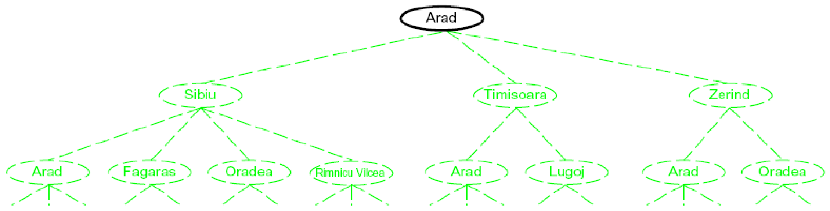
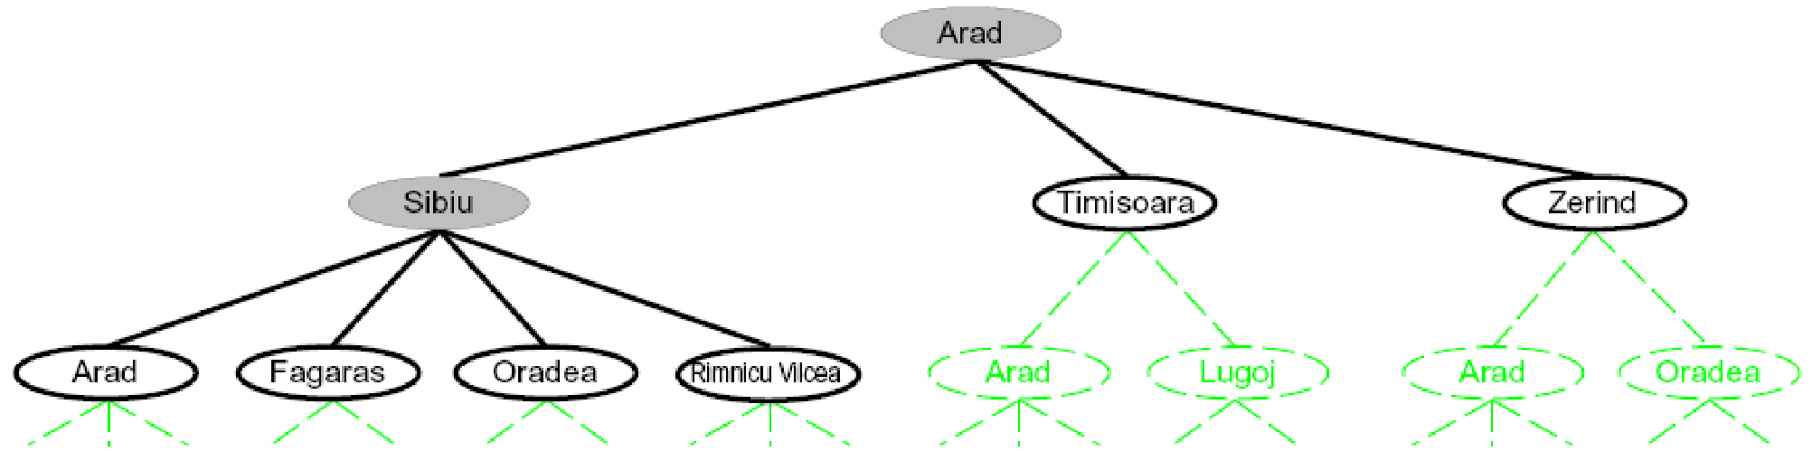
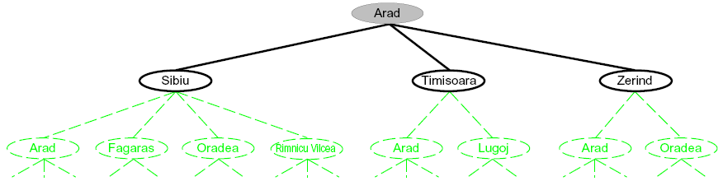
Searching with a Search Tree
Search:
  Expand out potential plans (tree nodes)
  Maintain a fringe of partial plans under consideration
  Try to expand as few tree nodes as possible

Slide 15
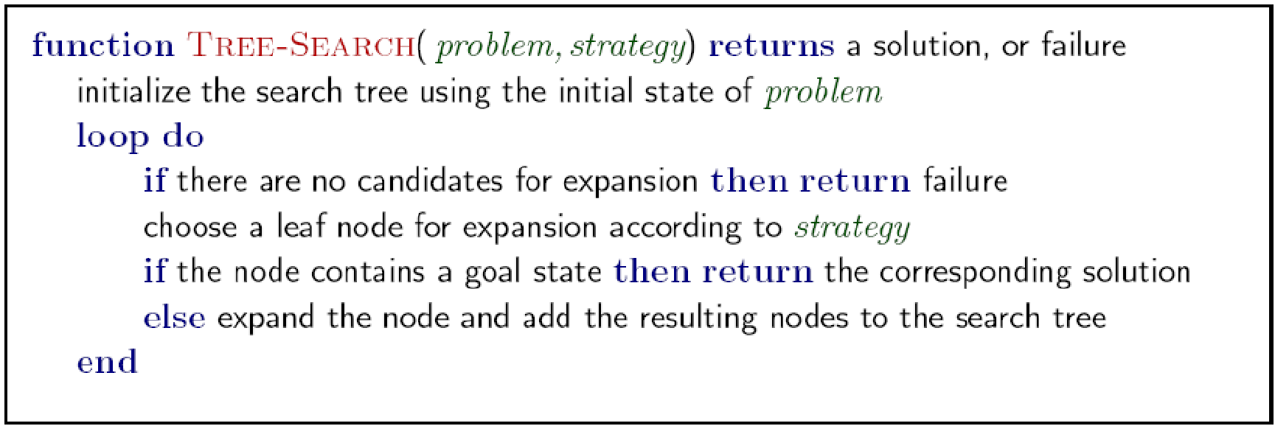
General Tree Search
Important ideas:
  Fringe
  Expansion
  Exploration strategy
Main question: which fringe nodes to explore?

Slide 16
Example: Tree Search
a
G
b
c
d
e
f
S
h
p
q
r
Notes:
Left: show tree
Right: fringe

Slide 17
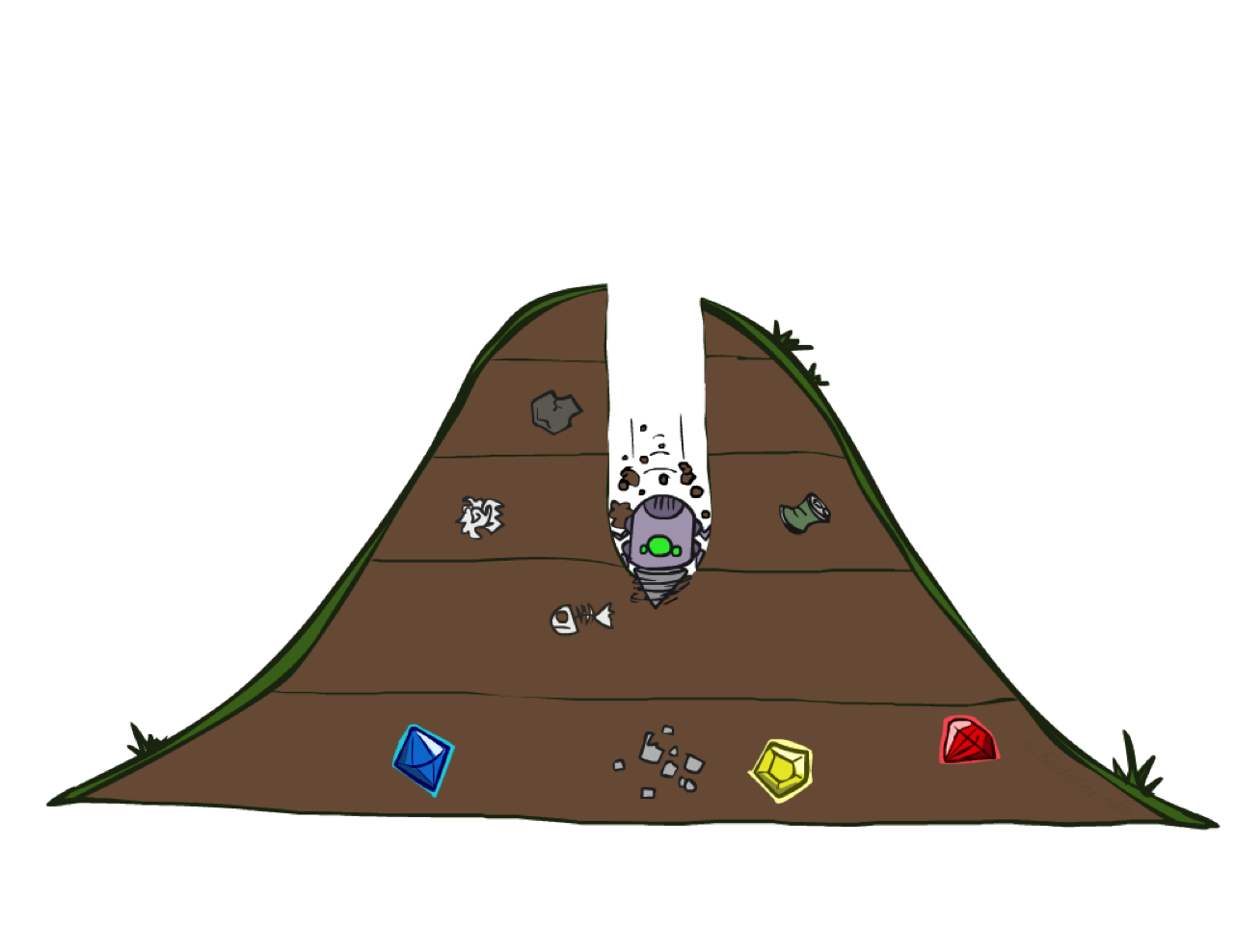
Depth-First Search

Slide 18
Depth-First Search
Strategy: expand a deepest node first
Implementation: Fringe is a LIFO stack
a
G
a
c
b
c
b
e
d
e
d
f
f
S
h
h
p
p
r
q
r
q
S
d
e
p
b
c
e
h
r
q
a
a
h
r
p
q
f
p
q
f
q
c
G
q
c
G
a
a

Slide 19
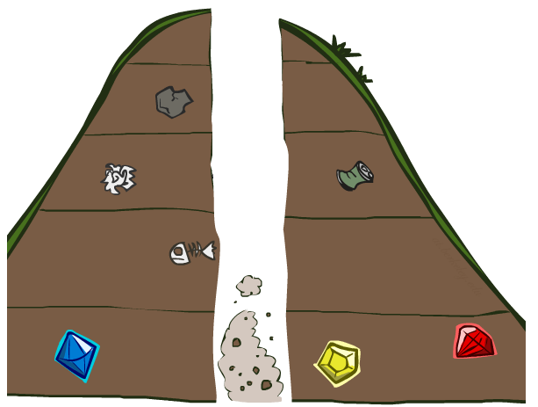
Search Algorithm Properties

Slide 20
Search Algorithm Properties
Complete: Guaranteed to find a solution if one exists?
Optimal: Guaranteed to find the least cost path?
Time complexity?
Space complexity?
Cartoon of search tree:
  b is the branching factor
  m is the maximum depth
  solutions at various depths
Number of nodes in entire tree?
  1 + b + b² + …. b^{m} = O(b^{m})
1 node
b
…
b nodes
b² nodes
m tiers
b^{m} nodes

Slide 21
Depth-First Search (DFS) Properties
What nodes DFS expand?
  Some left prefix of the tree.
  Could process the whole tree!
  If m is finite, takes time O(b^{m})
How much space does the fringe take?
  Only has siblings on path to root, so O(bm)
Is it complete?
  m could be infinite, so only if we prevent cycles (more later)
Is it optimal?
  No, it finds the “leftmost” solution, regardless of depth or cost
1 node
b
…
b nodes
b² nodes
m tiers
b^{m} nodes

Slide 22
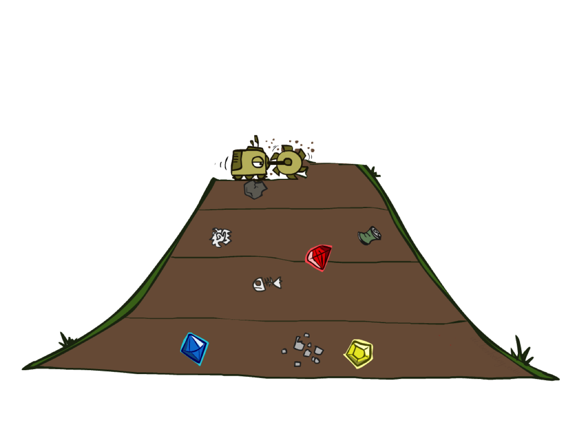
Breadth-First Search

Slide 23
Breadth-First Search
Strategy: expand a shallowest node first
Implementation: Fringe is a FIFO queue
a
G
b
c
d
e
f
S
h
p
q
r
S
d
e
p
Search
Tiers
b
c
e
h
r
q
a
a
h
r
p
q
f
p
q
f
q
c
G
q
c
G
a
a

Slide 24
Breadth-First Search (BFS) Properties
What nodes does BFS expand?
  Processes all nodes above shallowest solution
  Let depth of shallowest solution be s
  Search takes time O(b^{s})
How much space does the fringe take?
  Has roughly the last tier, so O(b^{s})
Is it complete?
  s must be finite if a solution exists, so yes!
Is it optimal?
  Only if costs are all 1 (more on costs later)
1 node
b
…
b nodes
s tiers
b² nodes
b^{s} nodes
b^{m} nodes

Slide 25
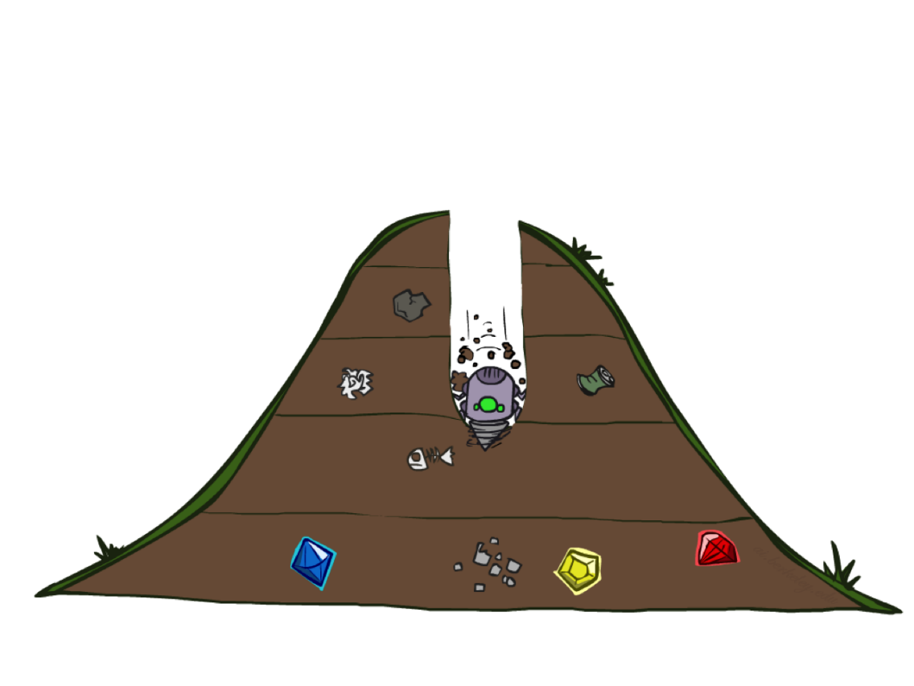
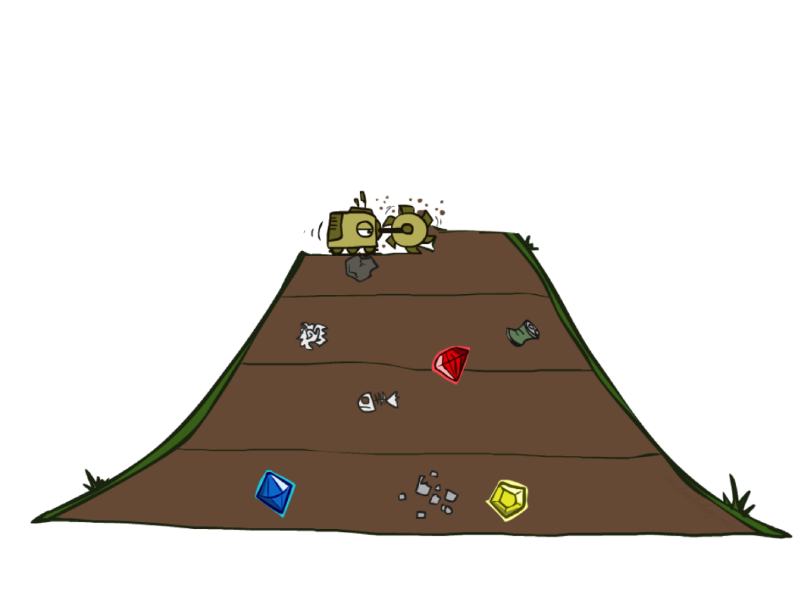
Quiz: DFS vs BFS

Slide 26
Quiz: DFS vs BFS
When will BFS outperform DFS?
When will DFS outperform BFS?
[Demo: dfs/bfs maze water (L2D6)]

Slide 27
Quiz: DFS vs BFS
Scenario | BFS Better? | DFS Better?
Finding shortest path | ✅ Yes | ❌ No
Shallow & wide search space | ✅ Yes | ❌ No
Deep & narrow search space | ❌ No | ✅ Yes
Memory-constrained environments | ❌ No | ✅ Yes
Finding any solution (not optimal) | ❌ No | ✅ Yes
Solution is close to root | ✅ Yes | ❌ No

Slide 28
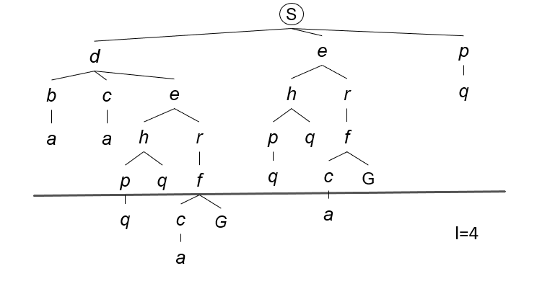
Depth Limited Search (DLS)
Strategy: use DFS with a depth limit
a
G
b
c
d
e
f
S
h
p
q
r

Slide 29
Depth Limited Search (DLS) Properties
Complete: Guaranteed to find a solution if one exists?
Optimal: Guaranteed to find the least cost path?
Time complexity?
Space complexity?

Slide 30
Iterative Deepening
Idea: get DFS’s space advantage with BFS’s time / shallow-solution advantages
  Run a DFS with depth limit 1. If no solution…
  Run a DFS with depth limit 2. If no solution…
  Run a DFS with depth limit 3. …..
Isn’t that wastefully redundant?
  Generally most work happens in the lowest level searched, so not so bad!
b
…

Slide 31
Cost-Sensitive Search
a
GOAL
2
2
b
c
3
2
1
8
2
e
d
f
3
9
8
2
START
h
1
4
2
p
4
r
15
q
BFS finds the shortest path in terms of number of actions.
It does not find the least-cost path. We will now cover
a similar algorithm which does find the least-cost path.

Slide 32
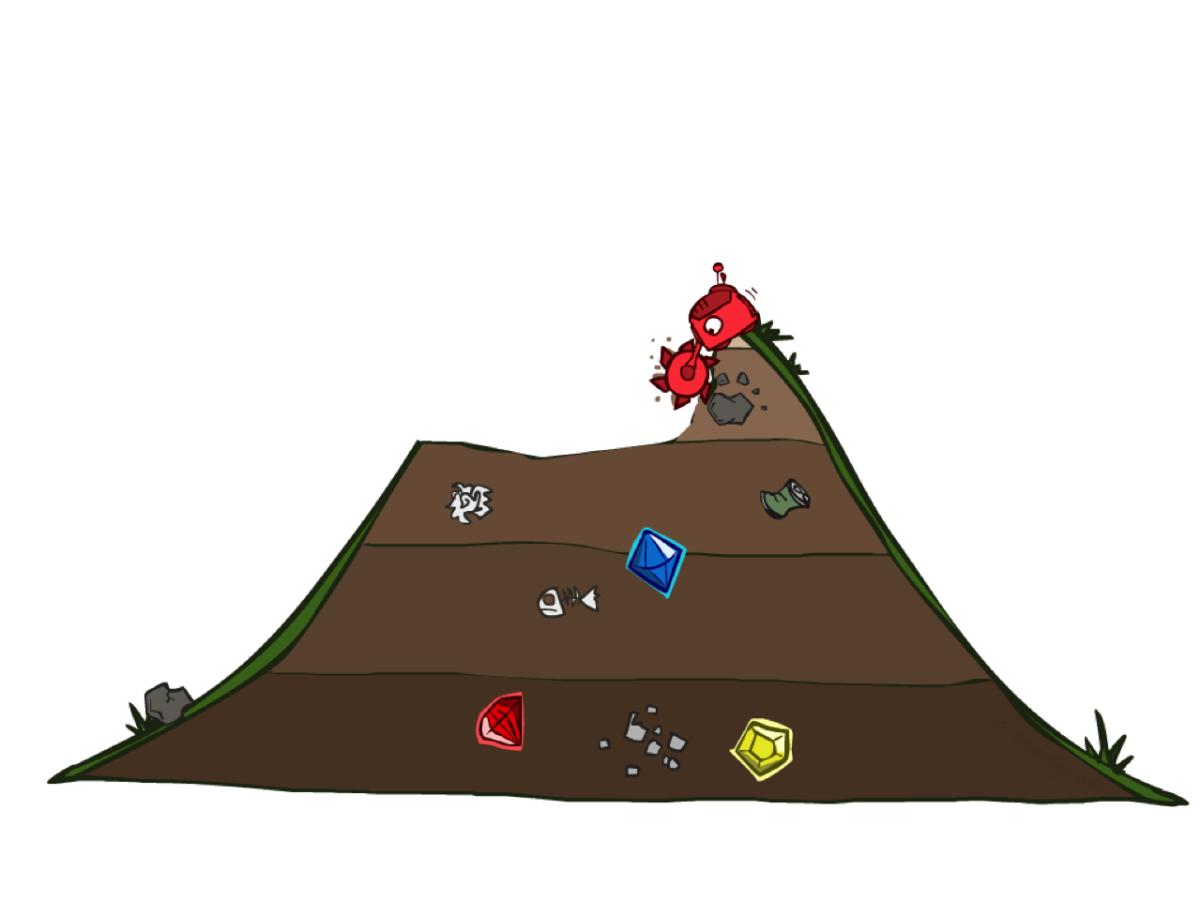
Uniform Cost Search

Slide 33
Uniform Cost Search
2
G
a
Strategy: expand a cheapest node first:
Fringe is a priority queue (priority: cumulative cost)
b
c
1
8
2
2
e
3
d
f
9
8
2
S
h
1
1
p
q
r
15
0
S
d
3
e
9
p
1
b
4
e
5
h
17
r
11
q
16
c
11
Cost contours
a
6
a
h
13
r
7
p
q
f
p
q
f
8
q
c
G
q
c
a
11
G
10
a

Slide 34
Uniform Cost Search (UCS) Properties
What nodes does UCS expand?
  Processes all nodes with cost less than cheapest solution!
  If that solution costs C* and arcs cost at least ε , then the “effective depth” is roughly C*/ε
  Takes time O(b^{C*/ε}) (exponential in effective depth)
How much space does the fringe take?
  Has roughly the last tier, so O(b^{C*/ε})
Is it complete?
  Assuming best solution has a finite cost and minimum arc cost is positive, yes!
Is it optimal?
  Yes!
b
c ≤ 1
…
C*/ε “tiers”
c ≤ 2
c ≤ 3

Slide 35

Uniform Cost Search (UCS) Demo

Slide 36
Uniform Cost Issues
Remember: UCS explores increasing cost contours
The good: UCS is complete and optimal!
The bad:
  Explores options in every “direction”
  No information about goal location
We’ll fix that soon!
…
c ≤ 1
c ≤ 2
c ≤ 3
Start
Goal

Slide 37
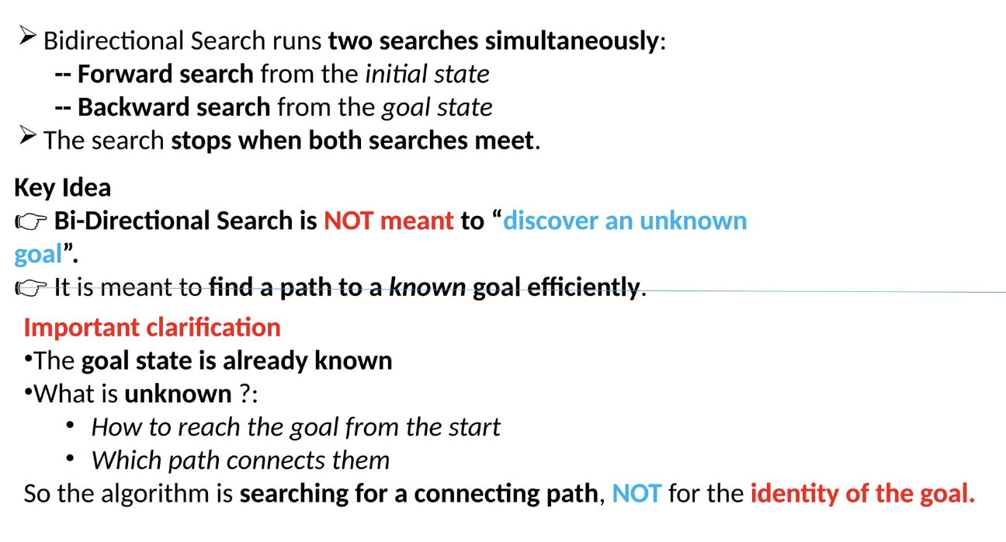
Bidirectional Search

Slide 38
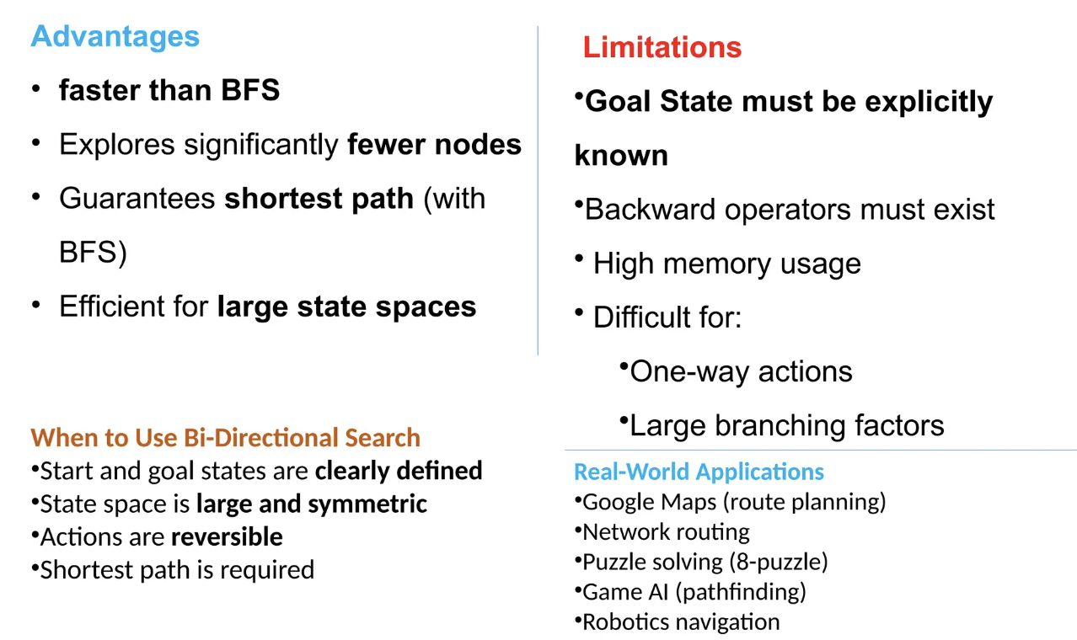
Bidirectional Search

Slide 39
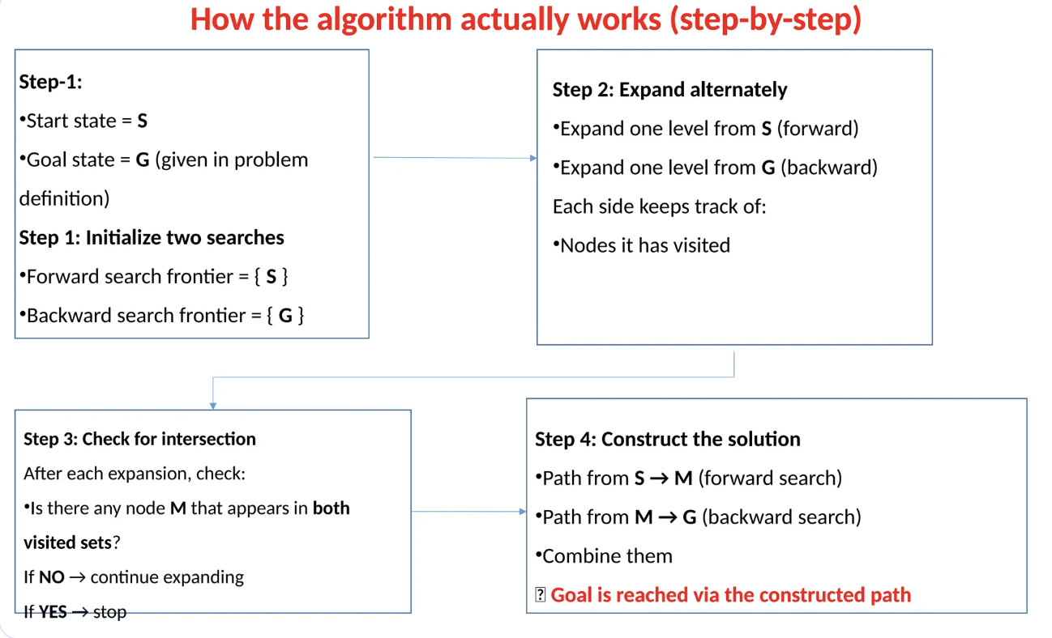
Bidirectional Search

Slide 40
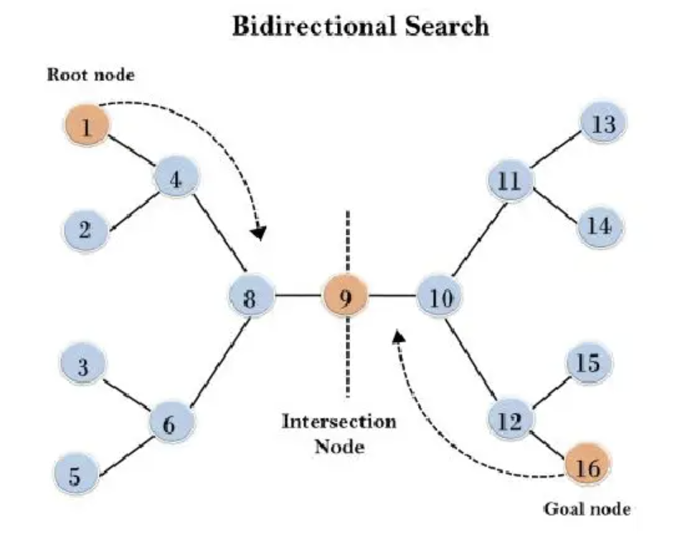
Bidirectional Search (Example)

Slide 41
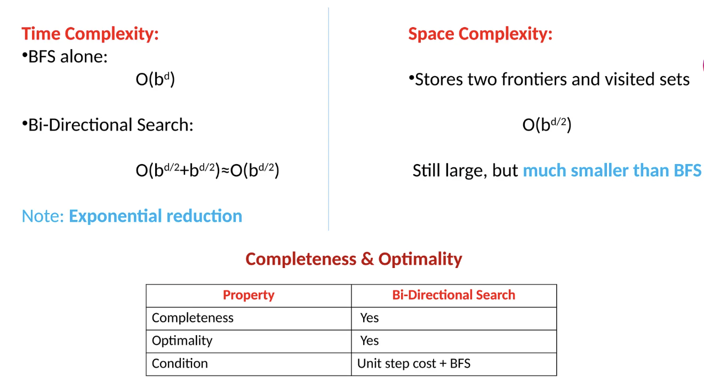
Bidirectional Search

Slide 42
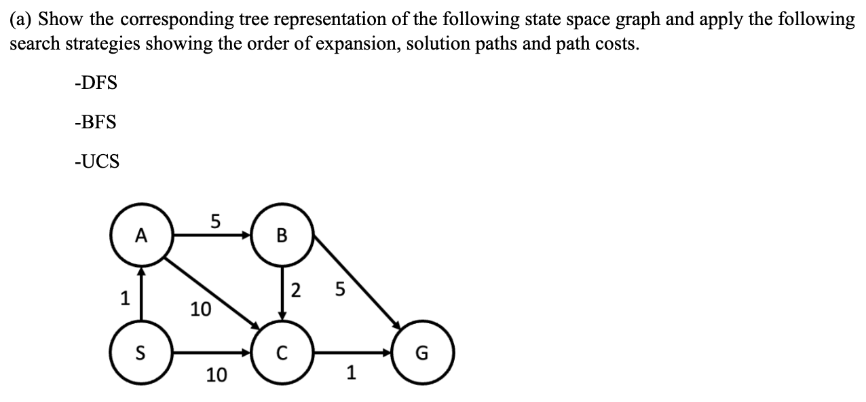
Example

